Slide 1
College App Using Augmented Reality

Slide 2
Our team
Mohamed Hamdy
Mohamed Kheer
Sayed Moataz
Hasnaa Khaled
Mohamed Remsh
Afnan Talaat

Slide 3
Table of contents
01
02
03
Problem vs. solution
App overview
Implementaion details

Slide 4
Introduction
Augmented Reality (AR) is a live view of a physical real-world environment whose elements are merged with (or Augmented by)virtual computer generated imagery.
With the help AR technology , information about the surrounding real world of the user becomes interactive and digitally usable.

Slide 5
01
Problem
vs. solution
WHY DID WE THINK OF THIS IDEA ?

Slide 6
WHY?
The college websites and applications are futile.
List of reasons :
They’re complex
Not uptodate with new technologies
Boring to use

Slide 7
Problem
-The old-fashioned way of the website without any interactive way to make it easy to use.
-we faced a lot of problems in college life like
we can't remember the places of rooms and halls also it takes a lot of time to reach it especially for newcomers and parents.
-also, we don't know the doctor's appointments if we want to meet them or for lectures.

Slide 8
Augmented Reality vs. Virtual Reality
Augmented reality
Virtual reality
Before we start discussion about the solution, AR shouldn’t be confused for VR.
An AR system adds virtual computer generated objects, audio and other sense enhancements to a real-world enviroment in real time.
VR is a completely simulated computer generated environment where everything is under the control of the system.

Slide 9
Solution
The solution is to try new way to implement college app by using augmented reality, which will make the app easier to use, more fun to use, more logically, offers a creative world and saves time and effort of the students.

Slide 10
If you want something new, you have to stop something old.

Slide 11
SWOT analysis
Strengths
S
W
Weaknesses
Making college life more attractive .
The limited theory of the use of AR in eduction.
Opportunities
O
T
Threats
Increasing the engagement of students to use the app.
Insufficient data connection.
Notes:
The aim of the SWOT analysis itself is to divide the strengths and weaknesses of the project in order to develop the strengths and improve the strengths of the organization. In this context, it is also necessary to expect the emergence of threats and opportunities.

Slide 12
02
APP overview

Slide 13
What is the project ?
A mobile application for college using augmented reality by making 3D virtual buttons to access functionality of the system such as make navigators in college , display the places of halls and classes , know information about the college like college history , college departments , college achievements , master fields information and faculty members by creating a new method by raising up mobile back camera to detect the sign of the doctor to show brief summary of doctor.

Slide 14
Stakeholders
The stakeholders of the system are students, administrator and guests.
Guests are doctors , teacher assistants , parents of students , new comers and anyone who want to know anything about the college.
Stakeholders will use back camera to interact with the system.

Slide 15

Application demo

Slide 16
How we implement it?
Starting with dividing the project into three modules.
Flutter model
Sign detection with Vuforia
ID card detection with Vuforia

Slide 17
Before we explain AR models we should explain the detection algorithm of Vuforia. The scale- invariant feature transform(SIFT)
A computer vision algorithm to detect, describe and match local features in images, invented by David lowe in 1999.
Used in applications include object recognition, robotic mapping and navigation, image stitching, 3D modeling, gesture recognition, video tracking, individual identification of wildlife and match moving.

Slide 18
How it works?
The first goal of a marker detection process is to find the outlines of potential markers, and then to deduce locations of marker’s corner in the image.
In addition, detection system needs to confirm that it really is a marker and decipher its identity.
Finally, the system calculates the pose using the information from the detected marker location.

Slide 19
The basic marker detection procedure consists of the following steps:
1. Image acquistion x
2. Preprocessing
3. Detection of potenial markers and discard of obvious non markers
4.Identification and decoding of markers
Acquisition of an intensity image
Low level image processing line detection of the corners of the marker
Template matching(template markers)
Decoding (data markers)
Fast rejection of obvious non-markers & fast acceptance test for potential markers
5.Calculation of the marker pose
Estimation of marker pose iterative pose calculation for accurate pose

Slide 20
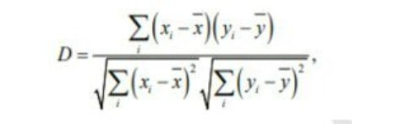
The image acquisition step is actually a separate process, it just provides the image for the marker detection process.
Usually Euclidean metrics is used, but another kind of metrics could be applied as well.

Slide 21
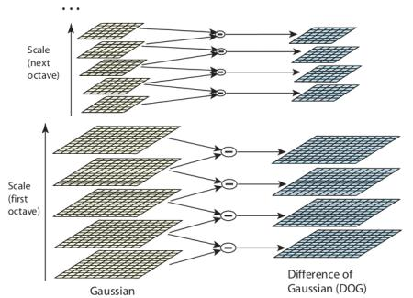
In normalized cross-correlation the dissimilarity is where x is mean of the marker’s pixel values and y is the template’s mean pixel value.
As a system needs to match the detected marker against each template four times, it is clear that the larger the set of markers the system uses, therefore, template markers are inefficient in practice if the system requires a large set of markers.

Slide 22
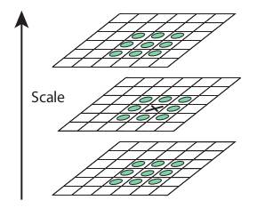

Slide 23
By using smart algorithms and other sensors such as accelerometers and gyroscopes the device can keep the augmented reality aligned with the image of the real world.

Slide 24
ID detection with Vuforia
First create image target which is pretrained and select ID cards and give them special number to separate them then made augmented reality environment by creating floating buttons attached to ID image.
Started to implement the buttons functionality to make the UI result appears, finally connect all this functions to MySQL data base to send and receive a real data that we simulated

Slide 25
Sign detection with Vuforia
We do it the same way as we develop ID model with some changes on functions
Last thing was creating a model that manages the AR models, it was easy to implement using Unity UI and scene manager built-in function
AR models acts like scenes in Unity.

Slide 26
Flutter Model
We use flutter written in dart language, which allows compiling a code quicker which it was the best option.
First, we design our application to display mainly things for guests like dean message and departments and so on and especially the AR model for students.

Slide 27
Challenge with Flutter
The challenge was how to connect flutter with Unity AR module?
We found a new package called flutter_unity , it’s working very well and we tested it,
It’s perfect package but there is a problem. It has an open issue that it accepts only one AR model and we have at least three AR modules so we should have 3 flutter apps and 3 projects.
It’s impossible, so we decided that we will make all of the AR modules in only one AR module it was a big challenge to do it, but we DID IT.

Slide 28

A picture always reinforces the concept
Images reveal large amounts of data, so remember: use an image instead of a long text. Your audience will appreciate it

Slide 29
—John Hanke
“Next we’re looking at how do we make that even more immersive, and how do we allow more people to have a shared experience together in a public space.”

Slide 30
Thanks!
Do you have any questions?

